Slide 1



FORMATION BASED UAV-PATH PLANNING
TEAM 2
MID-EVAL

Slide 2


Graph?
A graph is a data structure that consists of a set of nodes (vertices) and edges connecting them.
Vertices (nodes): Represent entities (e.g., cities, computers).
Edges (links): Represent connections or relationships between vertices
WHAT IS A GRAPH?
Undirected graph: edges have no direction
Directed graph: edges have direction.
Unweighted graph: edges treated as cost 1.
Weighted graph: edges have different cost.
TYPES OF GRAPH

Slide 3


Why only Graph?
It contains loops like real- world systems.
Makes complex systems understandable, navigable and solvable.
Represents dynamic connections or multiple paths.

Slide 4
Uses of Graphs
Navigation (maps)
Social Media
Network
USERS AS NODES, FRIENDSHIPS/FOLLOWS AS EDGES—USED IN FRIEND SUGGESTIONS
Devices as nodes, connections as edges—used in routing and data flow
Cities as nodes, roads as edges—used in GPS and route optimization.

Slide 5
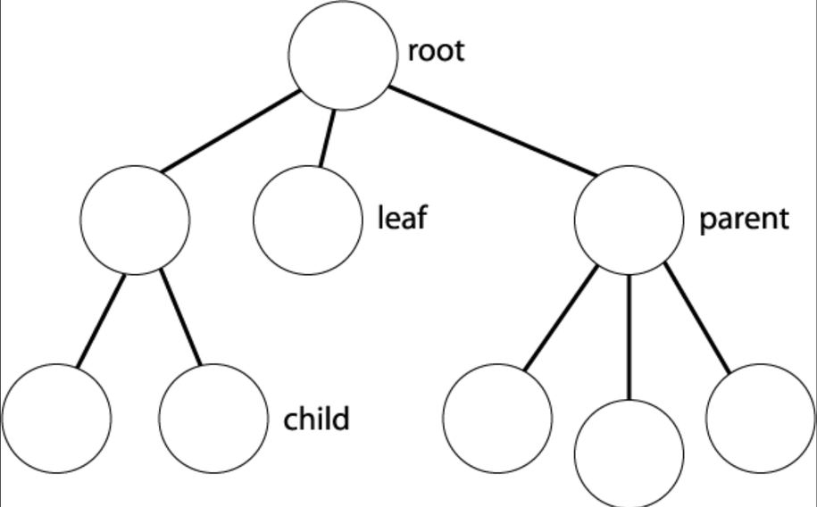
Tree ?
It is a special graph which has no cycles, no loops.
If it has N nodes then it has N-1 edges.
Root: Starting point.
Child: Directly connected to parent.
Leaf: Nodes with no children.

Slide 6
Graph Traversal Algorithms
SIMPLE GRAPH TRAVERSAL ALGORITHM
ADVANCED / INFORMED GRAPH SEARCH ALGORITHMS
BREADTH FIRST SEARCH(BFS)
DEPTH FIRST SEARCH(DFS)
DIJKSTRA’S ALGORITHM
(COST-BASED SHORTEST PATH)
A* Search Algorithm
(HEURISTIC-BASED OPTIMAL SEARCH)

Slide 7

DEPTH FIRST SEARCH(DFS)
WHAT IS DFS?
Depth-First Search (DFS) is a graph/tree traversal algorithm
DFS explores nodes by going as deep as possible along a path before backtracking.
It uses a stack (or recursion) and is useful for path finding, cycle detection, and connectivity checks.

Slide 8
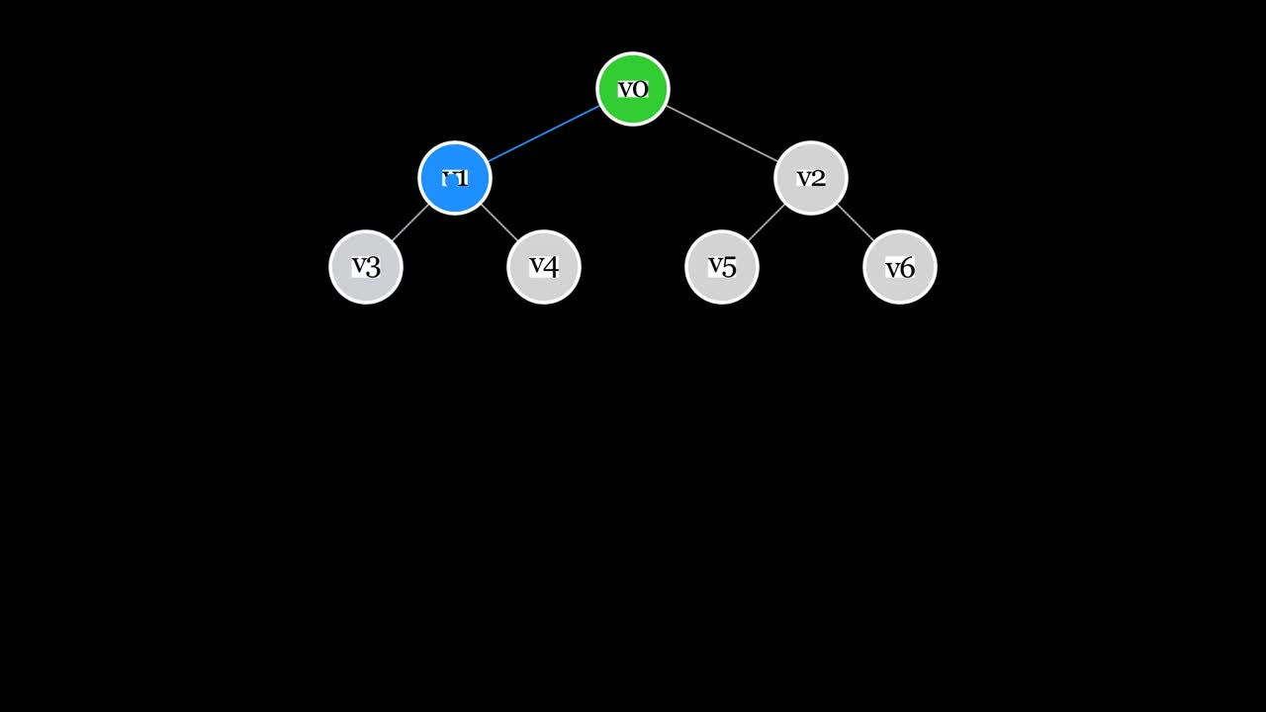
DEPTH FIRST SEARCH(DFS)
HOW DFS WORKS?
DFS starts from a node and explores as deep as possible along each branch before backtracking to explore other paths.
Starts at the root node.
Visit one adjacent node and keep going deeper
Backtrack when no unvisited nodes remain
Continue until all nodes are visited

Slide 9
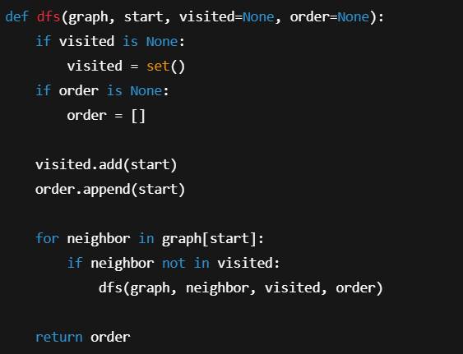
DEPTH FIRST SEARCH(DFS)
APPLICATIONS
CODE
Path finding and maze solving
Cycle detection in graphs
Topological sorting in DAGs
Finding connected components
Used in backtracking problems (e.g., puzzles)

Slide 10
BREADTH FIRST SEARCH(BFS)
WHAT IS BFS?
Breadth-First Search (BFS) is a graph/tree traversal algorithm
BFS explores a graph level by level, visiting all neighbors of a node before moving deeper.
Uses a queue data structure
Guarantees the shortest path in unweighted graphs
Commonly used in level-order traversal and connectivity problems

Slide 11
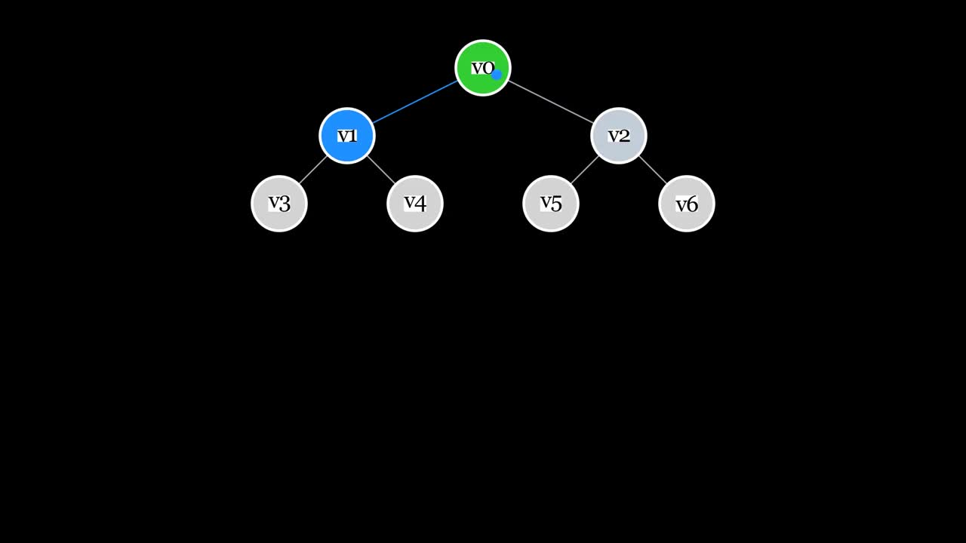
BREADTH FIRST SEARCH(BFS)
HOW BFS WORKS?
Start from the source node, mark it as visited, and insert it into a queue
Remove the front node from the queue and visit all its unvisited adjacent nodes
Mark each adjacent node as visited and add them to the queue
Repeat this process, ensuring nodes are processed level by level, until the queue becomes empty and all reachable nodes are visited

Slide 12
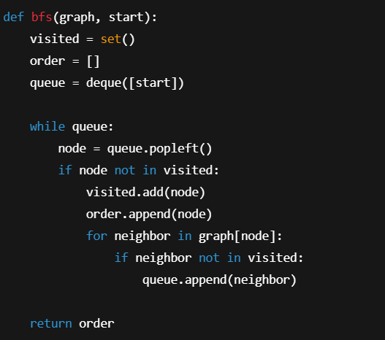
BREADTH FIRST SEARCH(BFS)
APPLICATIONS
CODE
• Finding shortest path in unweighted graphs
• Level-order traversal of trees
• Web crawling and social network analysis
• Finding minimum moves in games and puzzles
• Network broadcasting and routing

Slide 13
Dijkstra’s
Algorithm
Why Dijkstra?
Key Idea
BFS works only when all edges have equal cost, but real-world graphs often have weighted edges such as road lengths or tolls. We need an algorithm to find the shortest path in weighted graphs.
Dijkstra’s algorithm repeatedly selects the unvisited node with the smallest distance from the source and updates its neighboring edges. Once selected, the node’s shortest distance is finalized.

Slide 14
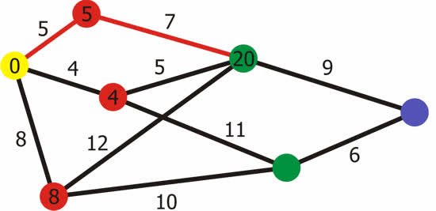
Algo
rithm
Input: Takes a weighted graph with non-negative edge weights and a source vertex
Initialize distance of the source to 0 and all other vertices to ∞
Use a priority queue to always select the vertex with minimum distance
Repeatedly:
Extract the closest unvisited vertex
Relax edges to update distances of its neighbors
Output: Computes the shortest distances (and paths) from the source to all vertices

Slide 15
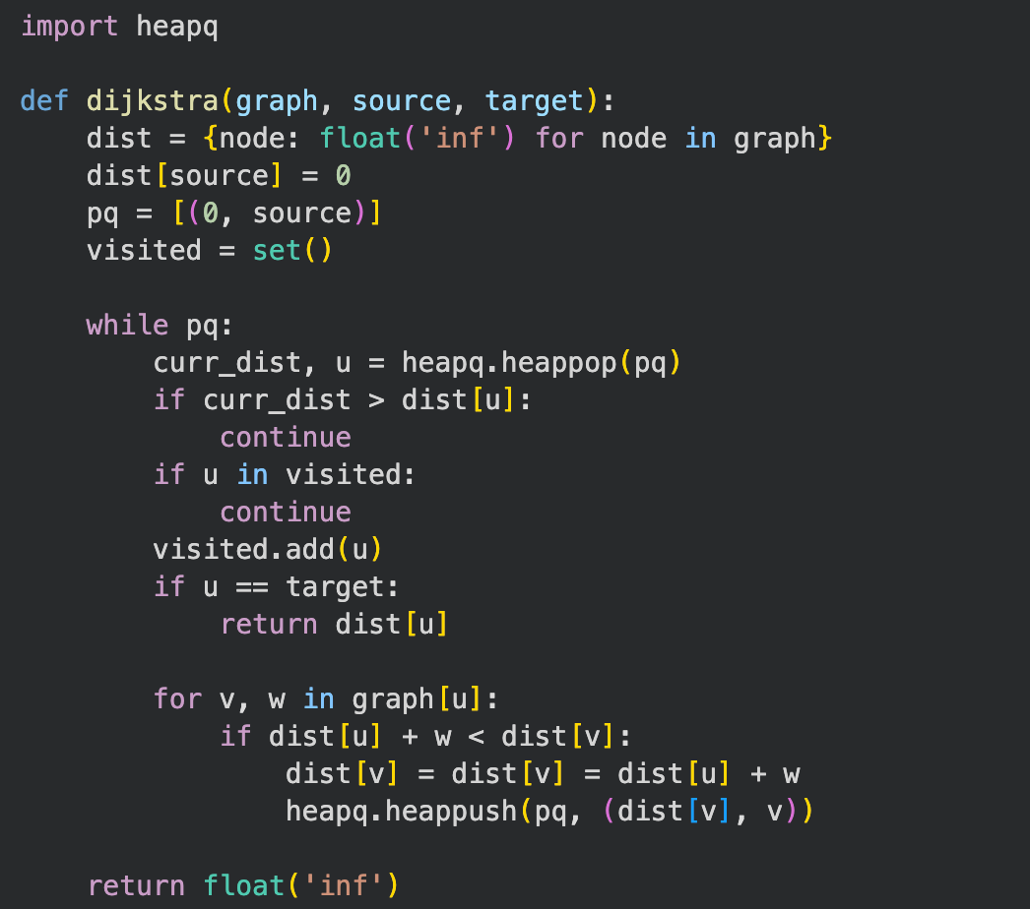
Algorihtm
Code

Slide 16
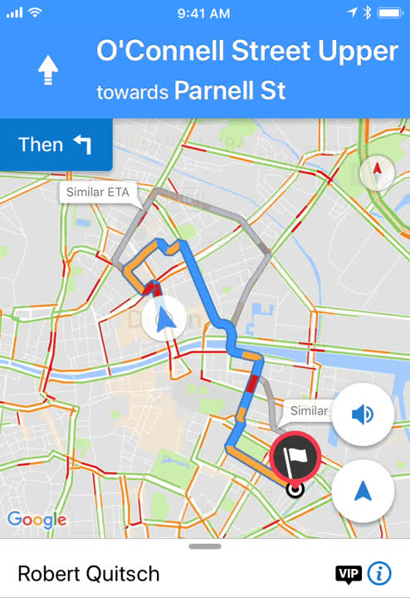
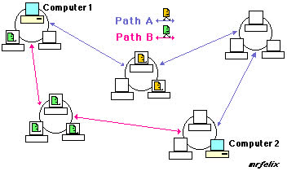
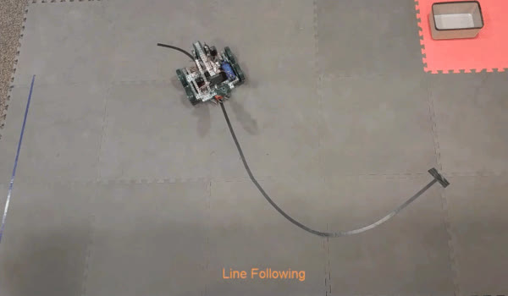
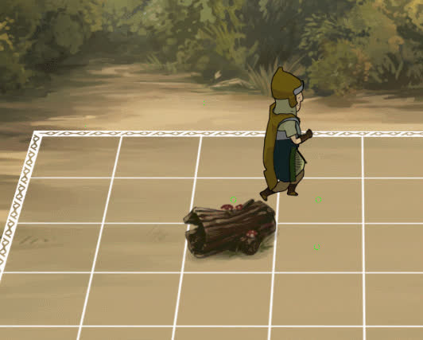
Applications
Network routing protocols
GPS / Google Maps routing
Robotics Navigation
Game Pathfinding

Slide 17
A* Search
Algorithm
• A* is an informed best-first search algorithm
Level-order traversal of trees.
• It is a variant of Dijkstra’s algorithm.
• The only difference is that an evaluation function is used to
determine which node to explore next.
• The evaluation function, f(x) = g(x) + h(x), is the estimated
total cost of a path going through Node x.
g(x): Cost of the best path discovered so far from the start node to node x
h(x): Heuristic estimate of the cheapest cost from Node x to the goal
Note: to gain a correct result, f(x) should never overestimates the cost to arrive at the goal node, i.e. h(x) must be less than the actual optimal cost to reach the goal

Slide 18
The Algorithm
Two Lists are used:
An open list, implemented as a priority queue, which stores the next nodes to be explored. Initially, the only node in this list is the start node S.
A closed list which stores the nodes that have already been evaluated. When a node is in the closed list, it means that the lowest-cost path to that node has been found.
Steps:
Initialize a tree with the root node being the start node S.
Remove the top node from the open list for exploration.
Add the current node to the closed list.
Add all nodes that have an incoming edge from the current node as child nodes in the tree.
Update the lowest cost to reach the child node.
Compute the evaluation function for every child node and add them to the open list.
All nodes except for the start node start with a lowest cost of infinity. The start node has an initial lowest cost of 0.
Note: The algorithm ends when the goal node G has been explored, NOT when it is added to the open list.

Slide 19
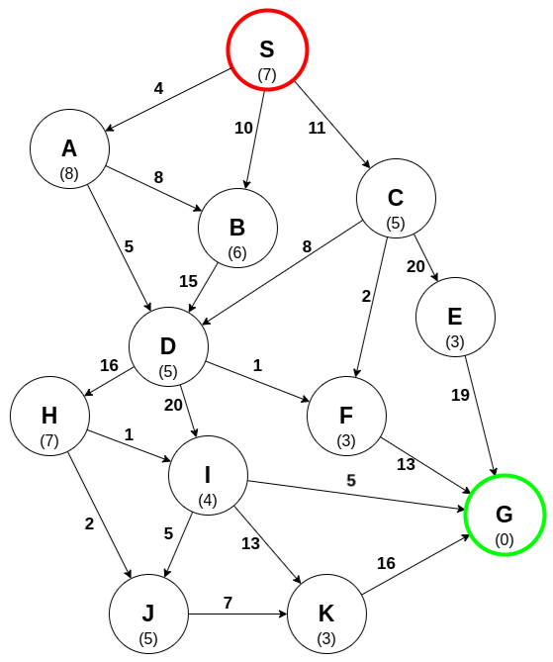
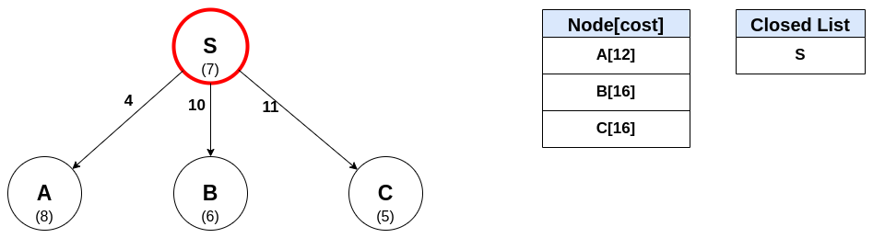
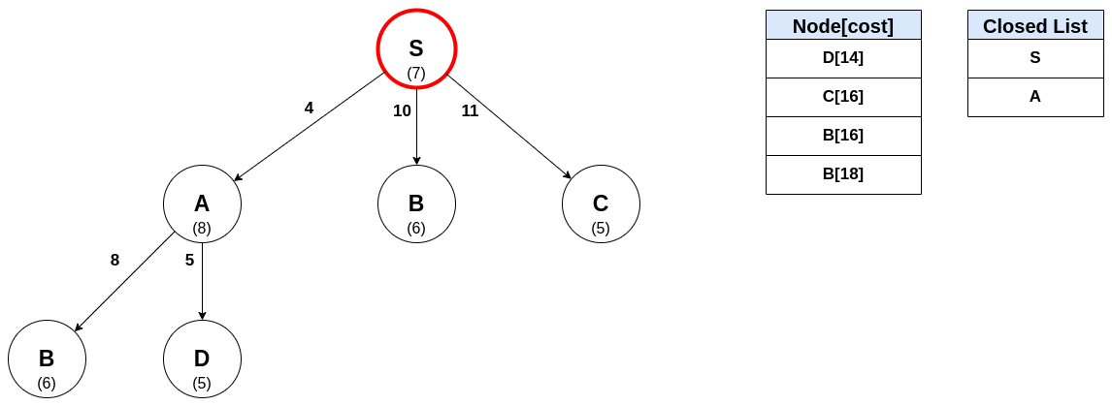
step1: explore S
step2: A is the current most promising path, so it is explored next

Slide 20
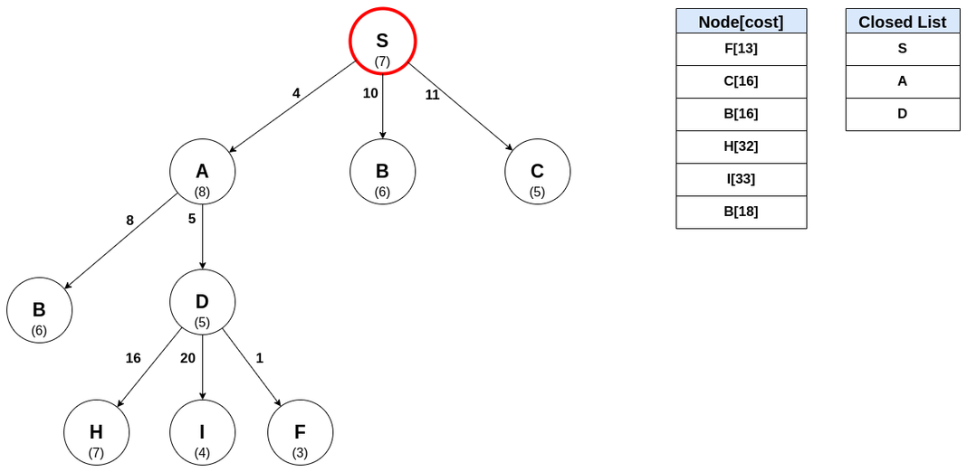
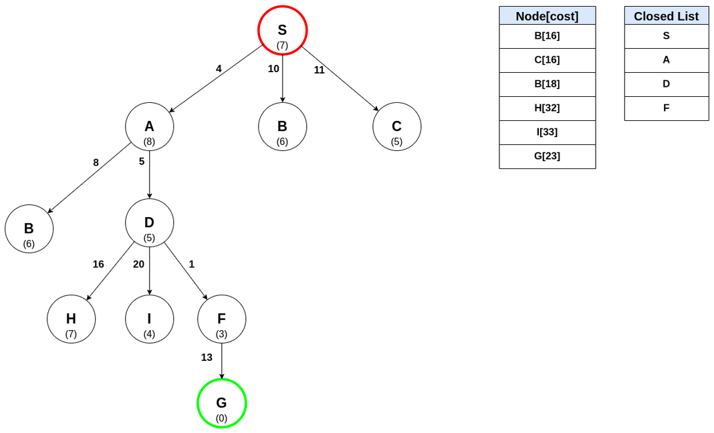
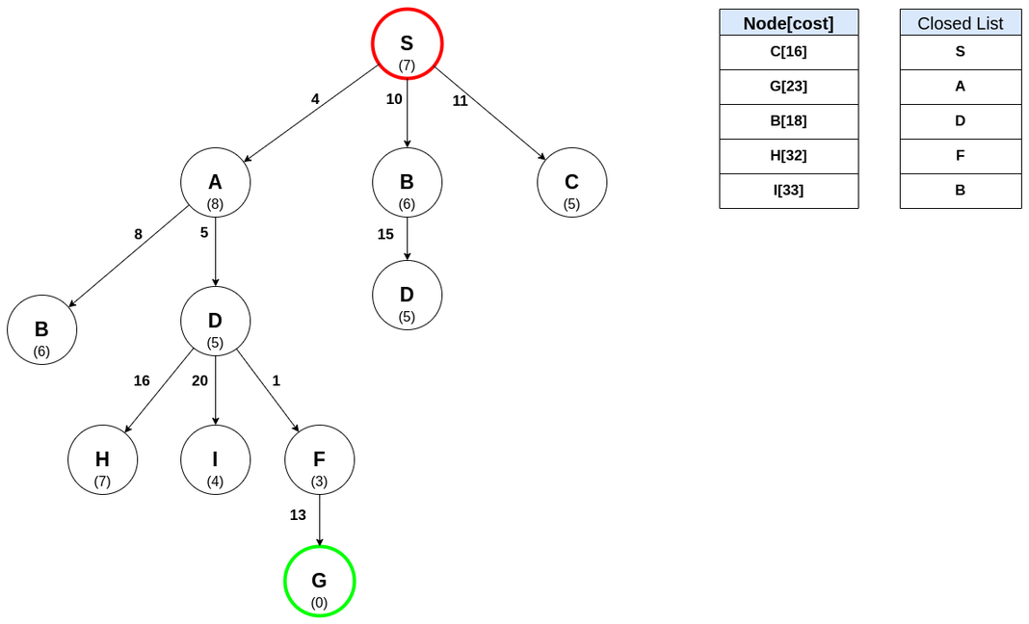
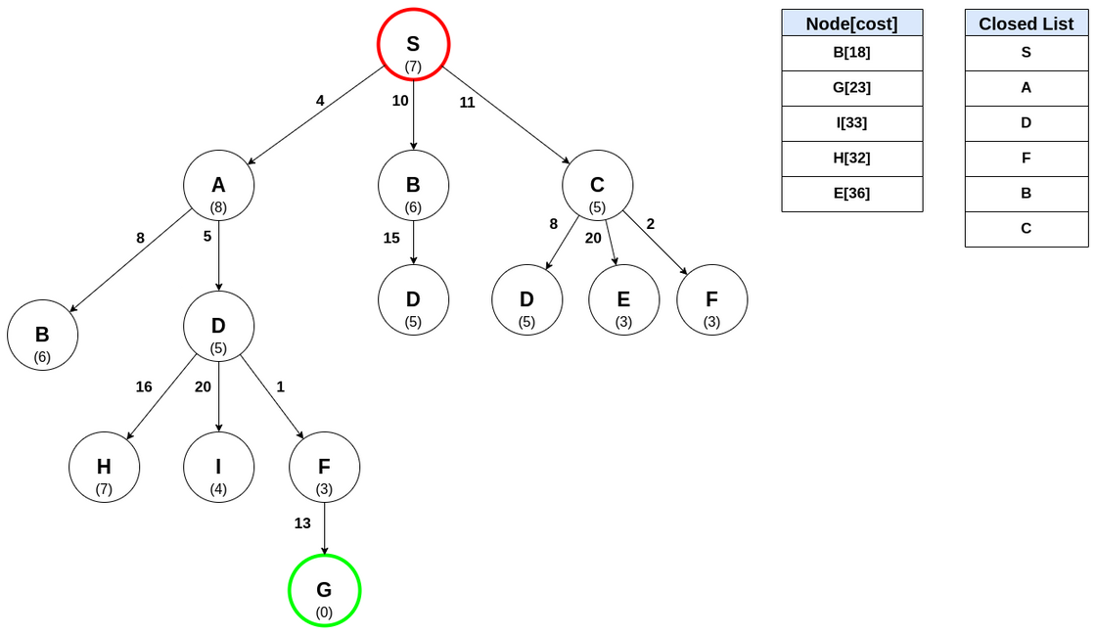
step4: explore F
step3: explore D
step5: Notice that the goal node G has been found. However, it hasn’t been explored, so the algorithm continues because there may be a shorter path to G. Eploring B
step6: exploring C

Slide 21
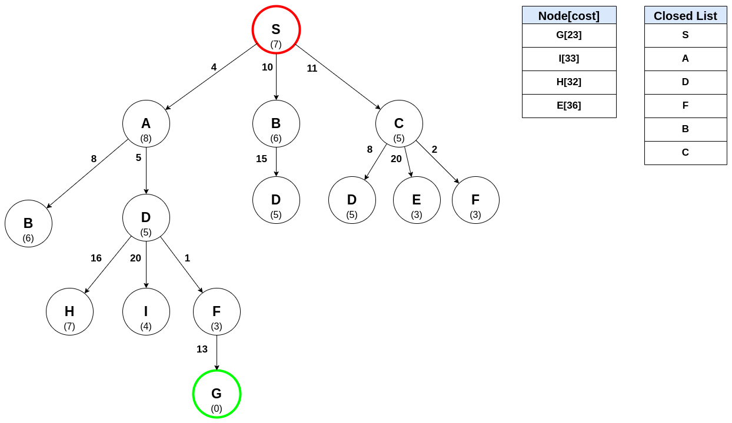
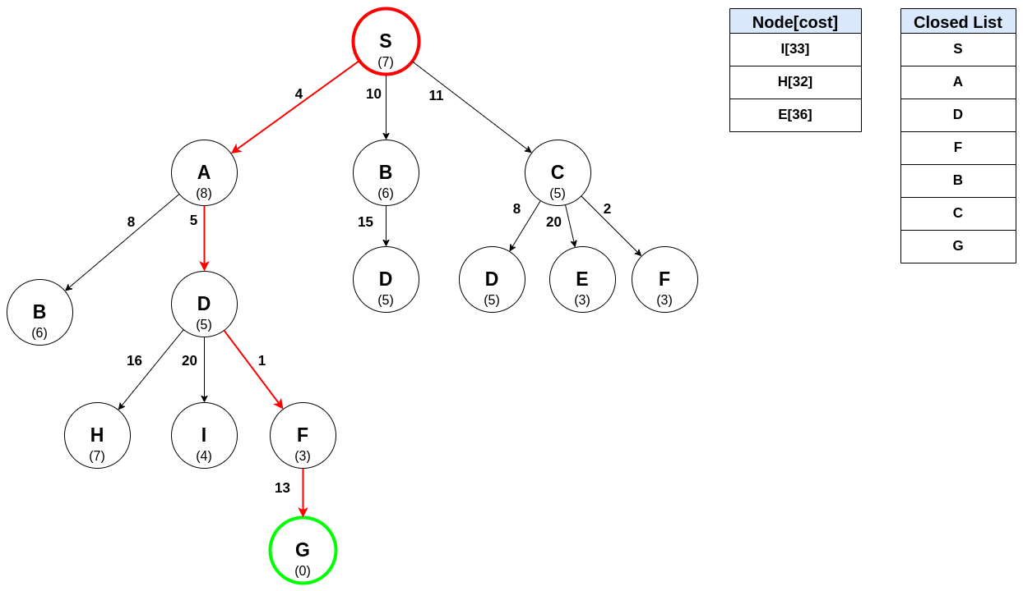
step7: The next node to be explored is the goal node G, meaning the shortest path to G has been found!
step8: The next node to be explored is the goal node G, meaning the shortest path to G has been found!

Slide 22
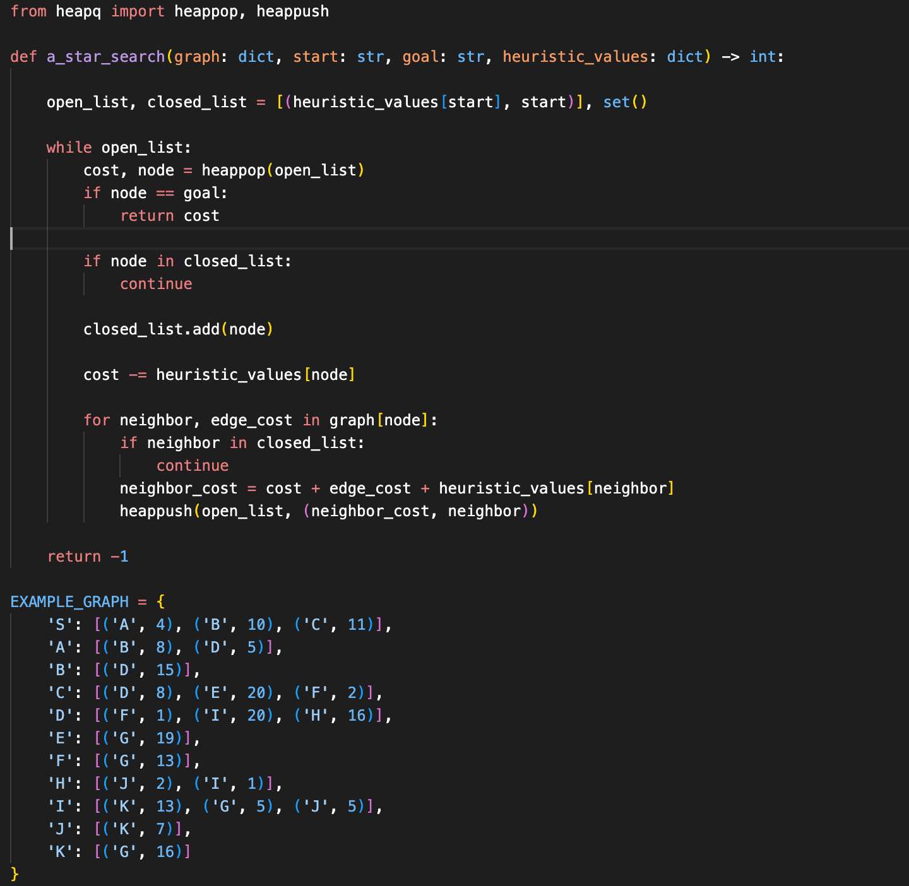

Slide 23
THANK YOU!
Members
Rajkumar Ahirwar
Aditya Kumar
Ahmad Akthar
Divya Mina

